Slide 1
MUSIC GENRE DETECTION WITH LIVE AUDIO
Under the Guidance of
Dr. Manmohan Sharma
Sasank. D 21BEC1429
Siva Kumar 21BEC1619
Lokesh 21BEC1705

Slide 2
Introduction
In the rapidly growing field of data-driven applications, audio analysis, and real-time predictions have gained significant importance. Traditional methods for processing audio data often face challenges in handling large volumes efficiently, especially when real-time predictions are required. This research focuses on developing a system that automates the process of audio data handling, dividing it into manageable chunks for accurate prediction. The primary challenge addressed in this study is the efficient processing and analysis of pre-recorded audio data. Handling continuous audio streams manually is impractical and prone to delays, making real-time predictions difficult. The goal is to automate the segmentation and prediction process, thereby enhancing the speed and accuracy of audio data analysis. The research focuses on processing pre-recorded audio data obtained from a microphone. The scope includes the automation of audio chunking and prediction but does not extend to real-time audio capture. The system is designed to be adaptable, although it is tested on specific datasets for validation.
Existing literature underscores the limitations of traditional audio processing methods, particularly in handling continuous data streams efficiently. While several approaches exist, they often lack automation and real-time capabilities. This research builds on these findings by introducing a scalable system that automates the preprocessing and predictive analysis of audio data. This paper proposes an automated system for chunking pre-recorded audio and predicting outcomes that significantly improves the efficiency and accuracy of audio data analysis compared to traditional manual methods.

Slide 3
This study bridges the gap between traditional audio processing and real-time predictive analytics. By automating the segmentation and prediction processes, the system provides quicker insights, which are crucial in applications like voice command recognition, speech analytics, and other audio-based systems.
The research aims to achieve the following objectives:
Automate the preprocessing of pre-recorded audio data by dividing it into smaller, manageable chunks.
Develop a predictive model capable of analysing each audio chunk to generate accurate predictions.
Evaluate the effectiveness of the system in real-time audio prediction scenarios.
The system employs a structured methodology comprising several stages:
Preprocessing: Capturing audio from a microphone, normalizing, reducing noise, and segmenting it into chunks.
Feature Extraction: Utilizing Mel-Frequency Cepstral Coefficients (MFCCs), spectrograms, and other 55 features to represent the audio data effectively.
Model Development: Training a machine learning model to predict the genre.
Evaluation: Testing the system on unseen data to know its accuracy and efficiency.

Slide 4
Problem Statement
The accurate and real-time classification of music genres from live audio streams remains a significant challenge in the field of audio analysis. Traditional methods rely on pre-recorded audio and offline processing, which are unsuitable for dynamic applications such as live music streaming, interactive music apps, and real-time feedback systems.
This project aims to address these challenges by developing an automated system capable of chunking live audio streams, analyzing them efficiently, and predicting music genres in real time. The proposed solution not only enhances the accuracy and speed of genre recognition but also expands the potential for applications like live music recommendations, audience engagement tools, and interactive entertainment platforms.

Slide 5
Research Objective
The primary objective of this research is to develop an efficient and accurate automated system for live music genre recognition by leveraging state-of-the-art deep learning techniques. Unlike traditional methods that rely on pre-recorded audio and offline analysis, this study focuses on real-time processing of live audio streams. The research aims to address critical challenges in the field, including:
Enhancing Accuracy: Improve the precision of music genre detection by experimenting with advanced architectures, including attention-based models and hybrid networks like CNN-LSTM combinations.
Real-time Processing: Develop a system capable of chunking live audio, analyzing it in real time, and providing instant predictions, thus meeting the demands of latency-sensitive applications.
Scalability Across Genres: Design a flexible framework capable of handling a wide variety of music genres, ensuring adaptability to new and emerging styles.
The ultimate goal is to bridge the gap between theoretical advancements in deep learning and practical deployment of music genre detection systems, making the technology accessible and effective for diverse applications.

Slide 6
Proposed Workflow
Introduction to the Proposed System
The proposed music genre detection system is designed to provide real-time genre classification using advanced deep learning techniques. By leveraging the power of Mel-frequency cepstral coefficients (MFCCs) for feature extraction and other 56 features and integrating them into a neural network model, this system ensures efficient and accurate genre prediction from audio inputs.
The architecture is modular, consisting of audio recording, feature extraction, classification, and real-time prediction and display, making it highly adaptable and user-friendly.

Slide 7
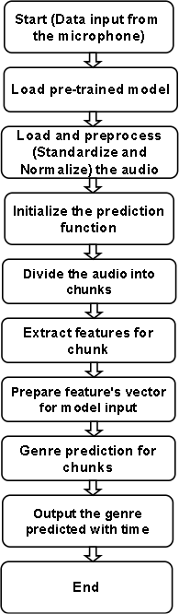
The following sections describe each component of the system in detail, accompanied by an algorithm outlining its functionality.
1. Audio Recording Module
This module captures live audio input from the user or environment using a microphone. It stores the recorded snippets as digital files for further processing. The main objective of this module is to acquire audio data in a format suitable for analysis.
Algorithm
Initialize the microphone input device.
Capture audio in predefined time intervals (30 seconds).
Save the captured audio in a digital format (i.e. WAV)

Slide 8
2. Data Transformation and Feature Extraction
In this module, the audio signal undergoes preprocessing to extract features crucial for genre detection. MFCCs are the primary features, capturing sound characteristics such as timbre, pitch, and rhythm. The audio is also transformed into a spectrogram for better frequency representation over time.
Algorithm
Load the recorded audio file.
Preprocess the audio:
Normalize the amplitude.
Apply framing (divide audio into overlapping windows).
Compute the spectrogram:
Apply the Short-Time Fourier Transform (STFT).
Extract MFCCs from each frame:
Compute mel-filterbanks.
Take the logarithm of filterbank energies.
Apply the Discrete Cosine Transform (DCT) to derive MFCCs.
Return the extracted MFCC features.

Slide 9
3. Classification
The classification module utilizes a neural network to categorize the extracted features into predefined genres. The model architecture includes convolutional layers for feature detection and fully connected layers for making predictions based on learned patterns.
Algorithm
Load the trained neural network model.
Input the extracted MFCC features into the model.
Perform forward propagation through the network:
Convolutional layers extract local patterns in spectrograms.
Fully connected layers aggregate these patterns to predict the genre.
Return the predicted genre label.
4. Real-Time Prediction and Display
This component ensures quick genre prediction and presents the results in a user-friendly interface. The system processes and categorizes the audio almost instantaneously, making it suitable for real-time applications.
Algorithm
Receive the audio input and preprocess it.
Extract MFCC features from the audio.
Pass the features through the trained model to obtain the predicted genre.
Display the predicted genre in the user interface.

Slide 10
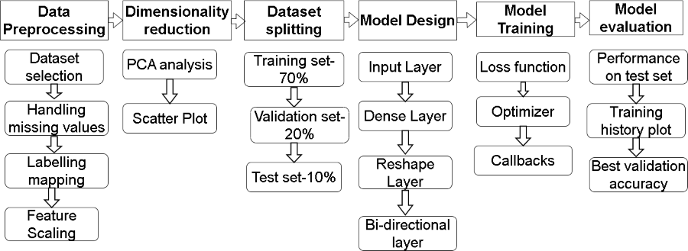
Implementation

Slide 11
Data pre-processing:
• Data Selection: Each sample in the raw dataset has a genre label that corresponds to one of the Blues, Classical, Country, Disco, Hip-hop, Jazz, Metal, Pop, Reggae, and Rock genres. Link for the data set: https://www.kaggle.com/datasets/andradaolteanu/gtzan-dataset-music-genre-classification
• Missing Values: Any columns containing missing or null values are detected.
• Label Encoding: Converting category labels(string format) to a numerical form of the training set, each music label is mapped to an index(0 to 9).
• Feature Scaling: Features of the audio are normalized with the MinMaxScaler function, now feature every value lies between 0 and 1.
The input size(number of features) are 57.
Number of samples(total number of rows): 9990.
Dataset Splitting:
The dataset is split into three sets:
Training Set: 70% of the data used for model training i.e. is 6993 out of 9990.
Validation Set: 20% of the data used to tune the model during training i.e. is 1978 out of 9990 records.
Test Set: 10% of the data used to evaluate the model’s final performance i.e. 1019 out of 9990 records.

Slide 12
Model Design:
Input Layer: The input shape consists of the number of features.
Fully Connected Dense Layers: To avoid overfitting and for steady learning, there are two dense layers of 1024 and 512 neurons respectively, with batch normalization and dropout (0.4).
Reshape Layer: The output is reshaped into 3D form to be processed by the LSTM layers .
Bidirectional LSTM Layers: A bidirectional LSTM layer with 128 units, with an attention layer to capture important temporal patterns.
A second bidirectional LSTM layer with 64 units processes the sequences .
Attention Mechanism: Self-attention is applied, where the input for this layer comes from the output from the LSTM output, helping the model focus on critical parts of the sequence.
Bottleneck Dense Layers: Narrowing the network through smaller dense layers (64, 32, and 16 neurons) gives compact feature representation [6].
Each dense layer with batch normalization and dropout layer avoids overfitting.
Output Layer: A softmax layer is used for final genre classification across 10 genres.

Slide 13
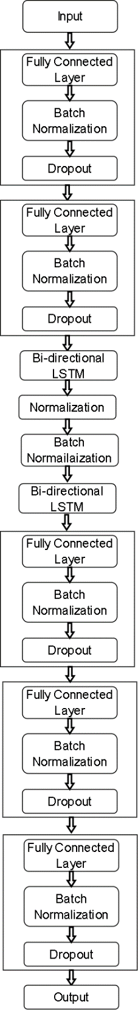
Model Training:
•Loss Function: Sparse categorical cross-entropy is used as the loss function because it is used for multi-class classification data sets.
•Optimizer: Adam optimizer is preferred because it is good at handling large data sets.
•Callbacks: A Learning Rate Scheduler adjusts the learning rate with epochs to tune the training process.
•Early Stopping is used to stop the training if the model’s performance does not improve on the validation set after a certain number of epochs, preventing overfitting.
Evaluation:
•Performance on Test Set: The model is evaluated on the test set to determine its accuracy and loss.
•Training History Plot: The accuracy and loss curves, are plotted to visualize the learning process.
•Best Validation Accuracy: The maximum validation accuracy achieved during training is printed.

Slide 14
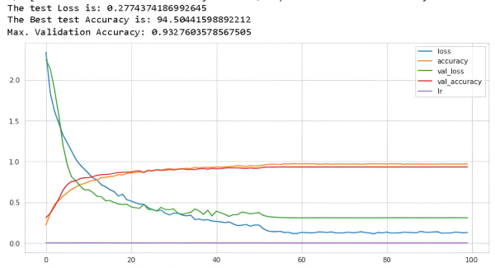
Results:
Accuracy Improvement:
Initial accuracy: ~26.6%
After 36 epochs: Accuracy went above 93 and validation accuracy stabilized at 91-92%
Loss Reduction:
Starting Loss: ~2.12%.
By epoch 36: Loss reduced to 0.27% with validation loss around ~0.35%.
No significant signs of overfitting were found as validation accuracy is improving along with training accuracy.

Slide 15
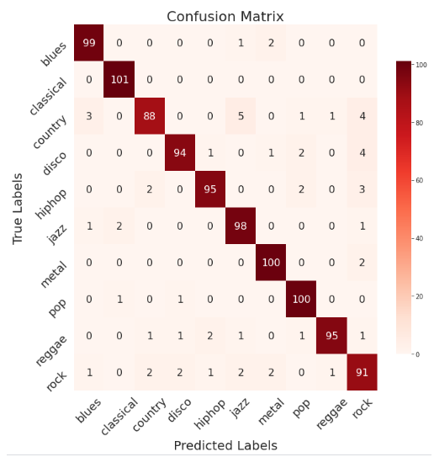
Notable observations from the confusion matrix report are:
The model’s overall accuracy of 94% on the test set is consistent across macro and weighted averages and it achieves high precision and recall across the majority of classes.
While class 8 has a slightly lower F1 score of 0.88, indicating that the model may struggle with a few instances in this category, classes 3, 4, 9 and 10 have exceptionally high scores, indicating strong predictive accuracy.
All things considered, the weighted averages and balanced macro indicate that the model functions consistently across all classes without being unduly biased toward any one of them.

Slide 16
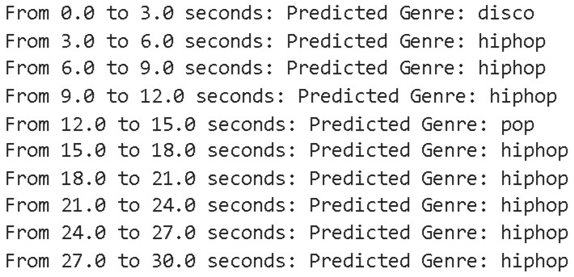
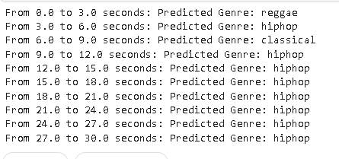
The system’s ability to correctly categorize musical genres across consecutive audio chunks, each linked to distinct time intervals. The audio input is divided into discrete time frames (every 3 seconds) so that the model can
process each chunk separately, extract pertinent features, and predict the genre.
Significant changes in the audio are quickly identified and
categorized thanks to the attention mechanism, which in particular enables the model
to prioritize crucial temporal features.

Slide 17
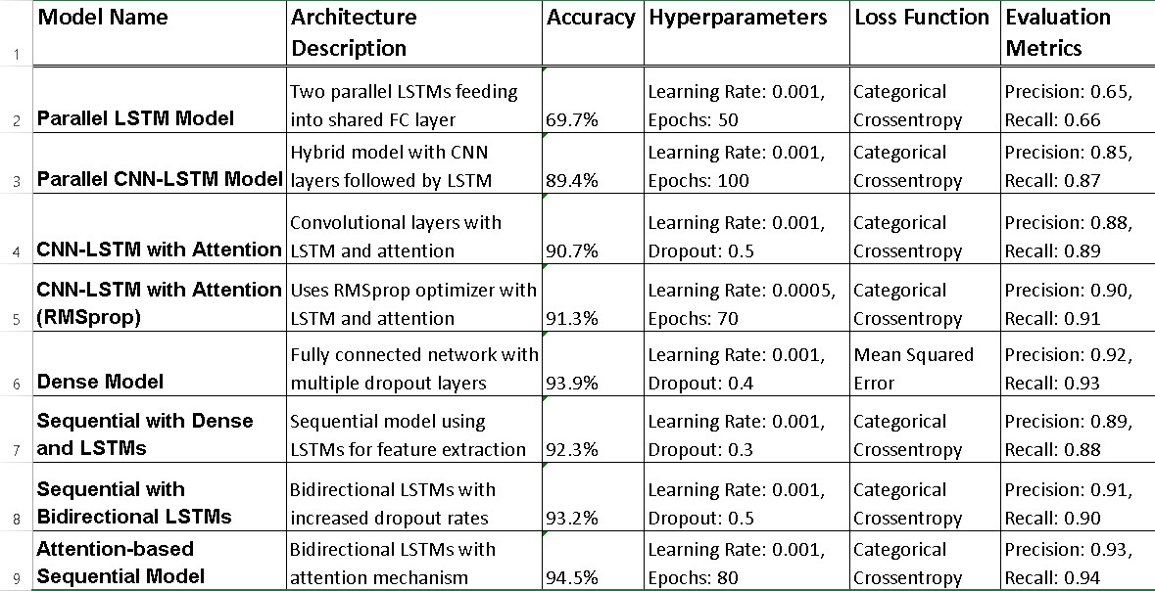
Comparisons

Slide 18
Interpretations
1. Parallel LSTM Model
Fast training due to the simple architecture.
Lower accuracy makes it less desirable for complex tasks.
2. Parallel CNN-LSTM Model:
High accuracy due to the combined strengths of CNN and LSTM.
The architecture is complex, which may lead to longer training times and higher computational costs.
3. CNN-LSTM with Attention
The attention mechanism improves learning and makes the model more robust.
Higher training time is a trade-off for better accuracy.
4. CNN-LSTM with Attention (RMSprop)
The use of RMSprop optimizer helps achieve better optimization.
Suitable for cases requiring slightly higher accuracy with balanced training times.
5. Dense Model
Simplicity of architecture is advantageous for faster implementation.
Risk of overfitting remains a concern, despite dropout layers.
6. Sequential with Dense and LSTMs
Effective for temporal data analysis due to the LSTM layers.
Balances complexity and performance well.
7. Sequential with Bidirectional LSTMs
Handles long-range dependencies effectively due to the bidirectional setup.
Higher dropout reduces overfitting risks while maintaining accuracy.
8. Attention-Based Sequential Model
Complex architecture provides the best accuracy.
Longer training times and higher computational costs are the trade-offs.

Slide 19
Conclusion
In this study, we explored the application of advanced machine learning models for genre classification from audio data. We showed that models that incorporate attention mechanisms and bidirectional LSTMs are more successful for capturing temporal patterns in audio sequences, reaching high accuracy rates, by utilizing various architectures, such as CNN-LSTM with Attention and Parallel LSTM structures. Applications where real time audio classification is crucial can benefit from this model-based approach’s high accuracy, scalability, and adaptability.
This system’s implementation has brought to light how crucial it is to adjust hyperparameters in order to maximize model performance. By carefully adjusting parameters such as dense layer sizes, LSTM units, and dropout rates, we were able to strike a delicate balance between model complexity and generalization.

Slide 20
Future work
1. Model Optimization for Real-Time Processing: Improving the model’s inference time and lowering latency will be crucial as the system grows to accommodate larger amounts of audio input. To guarantee real-time performance, it is important to look into strategies like model reduction, quantization, and deployment on edge
devices.
2. Enhanced Preprocessing: Trying out more sophisticated preprocessing methods, such wavelet transformations or spectrum augmentation, could enhance feature extraction and, eventually, the model’s capacity to recognize intricate audio patterns.
3. Exploring Multi-Model learning: Including extra data sources, such lyrics or metadata, may increase the precision of genre classification. Combining textual and audio characteristics in multi-modal learning techniques may offer a more comprehensive classification context.
4. Deploying in a Cloud-Based Environment: Real-time updates and large-scale processing can be supported by scaling the system to a cloud platform with dynamic resource allocation. Collaboration and convenient access across numerous devices would also be facilitated by a cloud implementation.

Slide 21
References
1. J. R. Hershey, Z. Chen, J. Le Roux and S. Watanabe, "Deep clustering: Discriminative embeddings for segmentation and separation," 2016 IEEE International Conference on Acoustics, Speech and Signal Processing (ICASSP).
2. Jahangir, R., Teh, Y.W., Hanif, F. et al, “Deep learning approaches for speech emotion recognition: state of the art and research challenges,” 2021 Multimed Tools Appl 2021.
3. Cheng, Yu-Huei & Chang, Pang-Ching & Kuo, Che-Nan, ”Convolutional Neural Networks Approach for Music Genre Classification,” 2020 International Symposium on Computer, Consumer and Control (IS3C).
4. Aggarwal, Shruti & Gurusamy, Vasukidevi & Sethuramalingam, Selvakanmani & Pant, Bhaskar & Kaur, Kiranjeet & Verma, Amit & Binegde, Geleta, ”Audio Segmentation Techniques and Applications Based on Deep Learning,” 2022 Scintific Programming.
5. A. Zeyer, P. Doetsch, P. Voigtlaender, R. Schlüter and H. Ney, "A comprehensive study of deep bidirectional LSTM RNNS for acoustic modeling in speech recognition," 2017 IEEE International Conference on Acoustics, Speech and Signal Processing (ICASSP)
6. Petridis, Stavros & Pantic, Maja,” Deep complementary bottleneck features for visual speech recognition,” 2016.
7. Jang, BY., Heo, WH., Kim, JH. et al. “Music detection from broadcast contents using convolutional neural networks with a Mel-scale kernel,”2019, EURASIP Journal on Audio, Speech, and Music Processing.
8. Poerner, Nina & Schiel, Florian. “An automatic chunk segmentation tool for long transcribed speech recordings,” 2016, Conference: Proceedings of the Phonetics & Phonology Conference (P&P)
9. Bonet-Solà D, Alsina-Pagès RM. A “Comparative Survey of Feature Extraction and Machine Learning Methods in Diverse Acoustic Environments,” 2021, Sensors (Basel).
10. Andrada. GTZAN Dataset for Music Genre Classification. 2020, Kaggle, https://www.kaggle.com/datasets/andradaolteanu/gtzan-dataset-music-genre-classification

